Slide 1
Making Inferences
What I Know +
What I See/Read
=
an Inference

Slide 2
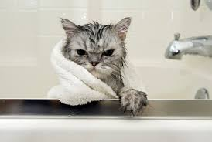
1. What do you infer?

Slide 3
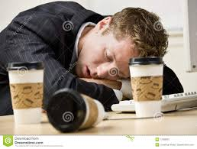
2. What do you infer?

Slide 4
3. What do you infer?

Slide 5
Let’s go back in time…

Slide 6
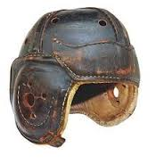
4. What do you infer it is?
Clue: Used in early pigskin games

Slide 7
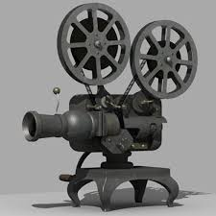
5. What do you infer it is?
Clue: Grab some popcorn and a drink

Slide 8
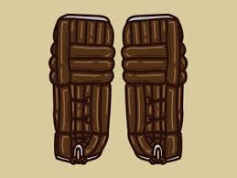
6. What do you infer it is?
Clue: Brrrr!!! These are used in an icy sport.

Slide 9
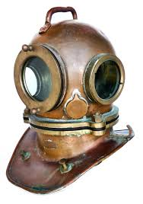
7. What do you infer it is?
Clue: Don’t have to hold your breath

Slide 10
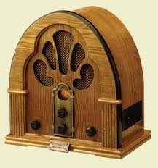
8. What do you infer it is?
Clue:

